Slide 1


Installation & Maintenance
By Paola Jiron

Slide 2
Installation
Once the file has been downloaded, unzip and run the application.
Make sure you have the appropriate software installed on your system. You may find the suitable instructions on software installation under “Hardware and Software Resources”, page 16 of the Final Feature Document.
Open the project in Unity.
On the File section select all the scenes to open for build with the Menu scene as scene 0 (zero). This will be the first scene that will appear when the application is built.

Slide 3
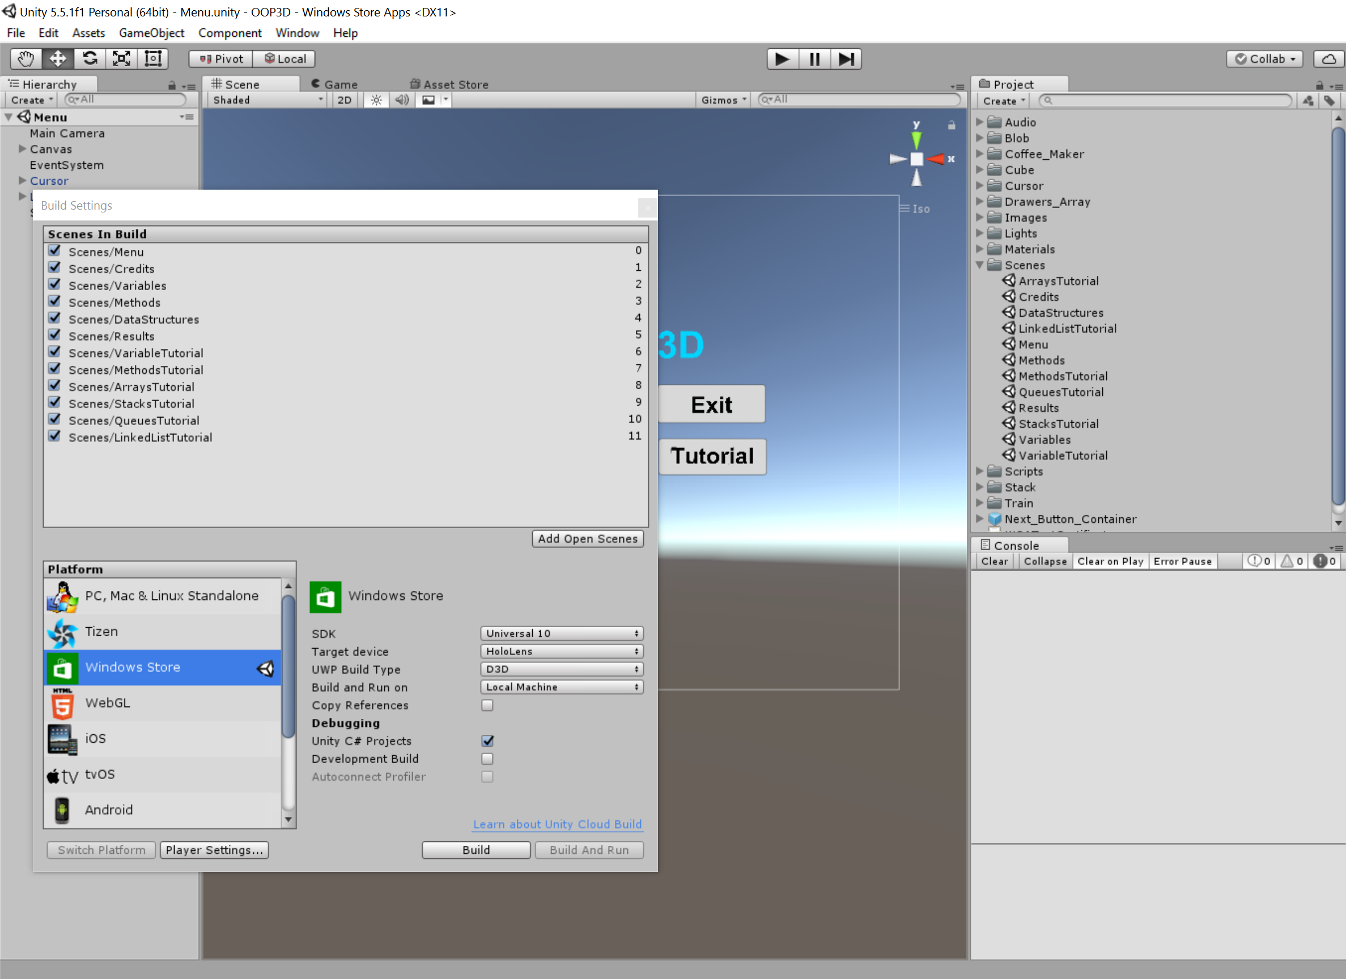
Installation ...continued
Select Windows Store and make all selections shown in the snapshot.
Click “Build and Run”.
A popup window will open. Here, create a new folder named “App” and save.
When the project has completed the Build, navigate inside the App folder and double click the .sln file
This will open Visual Studio.
Deploy the project (an error will show at first due to failure to connect to the device.
Deploy once again and it will succeed deployment.
Run the project.

Slide 4
Maintenance
The Hololens device software must be up-to-date for a smooth application build and deployment.
The device must also be charged.
If the device is not charged it will not acquire charge while connected to any PC or laptop due to the lack of AMPs needed to charge it.
Hololens must be clean and lint free.
Must keep the device away from liquids and hot temperatures.
Noisy and sunny areas must be avoided due to interactive voice recognition and graphics.

